Slide 1

DEEP LEARNING
Presentation - AE401A
Aditya Raghuwanshi (170052)

Slide 2


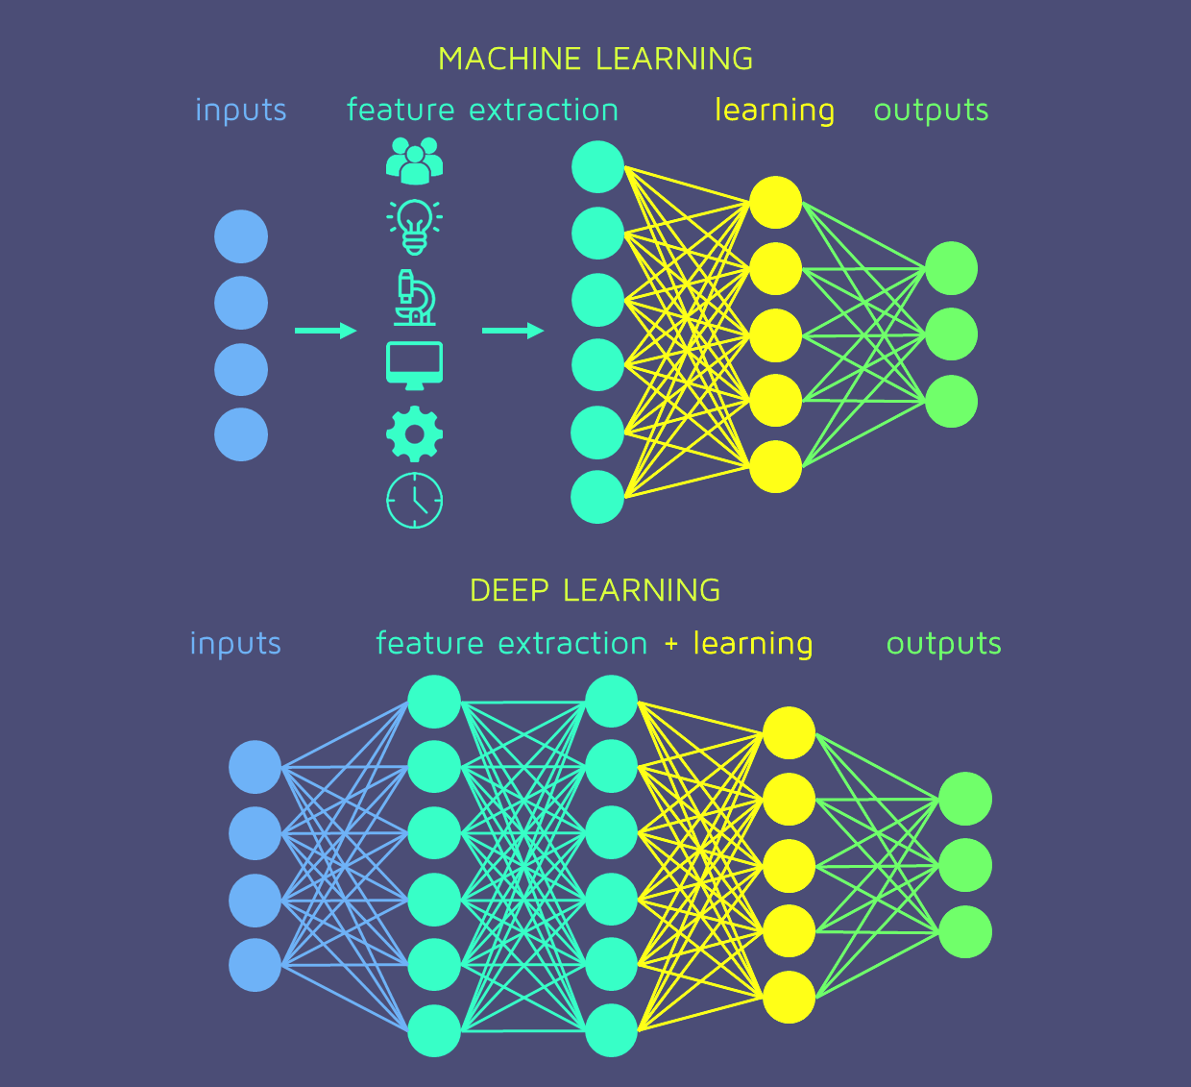


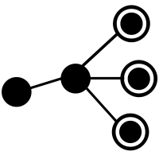
Introduction
Deep Learning uses a “Neural Networks” architecture to build models.
NN architecture is designed to work the same way a human brain does.
Deep Learning, unlike other machine learning techniques, performs feature engineering.
Deep Learning suits our ideal machine learning model imagination, “dump the data into the model and get prediction”.
Dump Input
Neural Network
Predictions

Slide 3

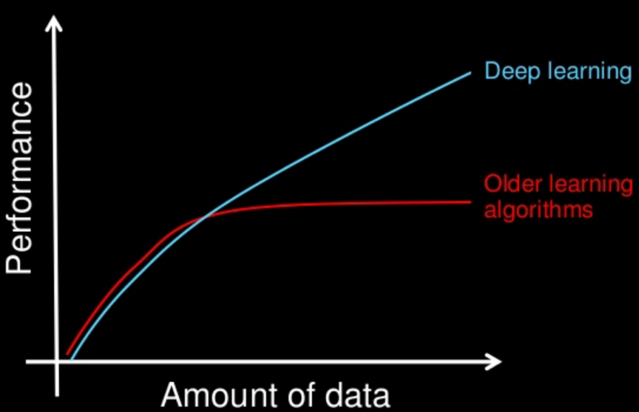









Motivation
DL outperform other techniques if the data size is large compared to other algos.
Deep Learning is fueled by “Big Data Era” and advancements in computational power.
It is used by world’s largest companies.

Slide 4

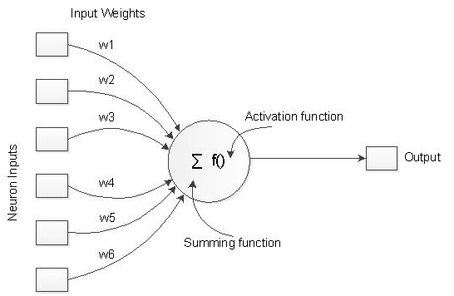

A Single Neuron (Node)
It is the fundamental unit of neural network
It performs a simple linear regression, more specifically does 2 operations:
Performs weighted sum of input and a bias term
Maps calculated sum to an activation function
Each neuron gets activated (or fire) by some feature(s) in the input data.
Takes output of previous layers as input, its output is used as input for next layer.
All weights and bias terms are the parameters to be learned by the model.

Slide 5

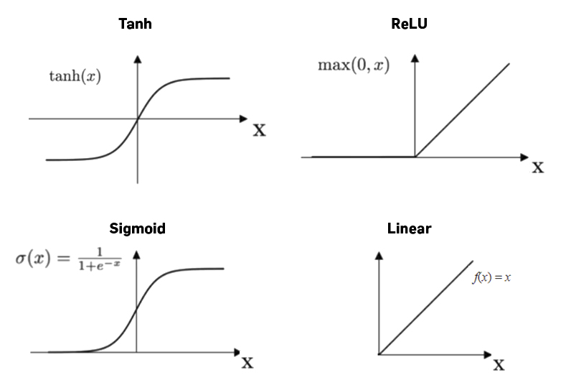
Activation Functions
Theoretically, output of a neuron can varies from -∞ to +∞.
Act. Fun. maps input to a desired range that avoids overflow and also outputs values which are more useful.
Nonlinear function are, usually, used to learn complex models
It can also learn probabilities of a class
They allow back propagation
Linear act. fun. are not useful
Most widely used activation functions are:
Sigmoid
Tanh
ReLu (Rectified Linear Unit)
Leaky ReLu

Slide 6

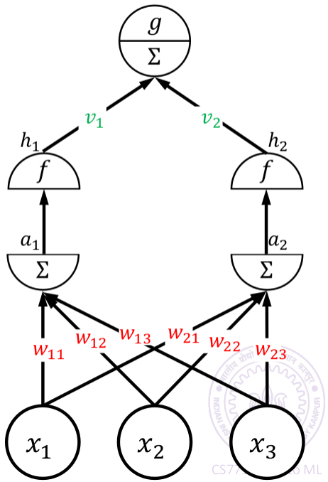

Building A Neural Networks
Image shows a simple neural network built with:
Input Layer, having 3 nodes
A Hidden Layer, having 2 nodes
Output Layer with single node
For layer 1, inputs = [x₁, x₂ ,x₃]
a₁ = w₁₁x₁+w₁₂x₂+w₁₃x₃
a₂ = w₂₁x₁+w₂₂x₂+w₂₃x₃
h₁=f(a₁) and h₂=f(a₂)
Outputs = [h₁, h₂]
For output layer, inputs = [h₁, h₂]
b = v₁h₁+v₂h₂
Output = g(b)
“f” and “g” are activation functions
This is known as Forward Propagation

Slide 7
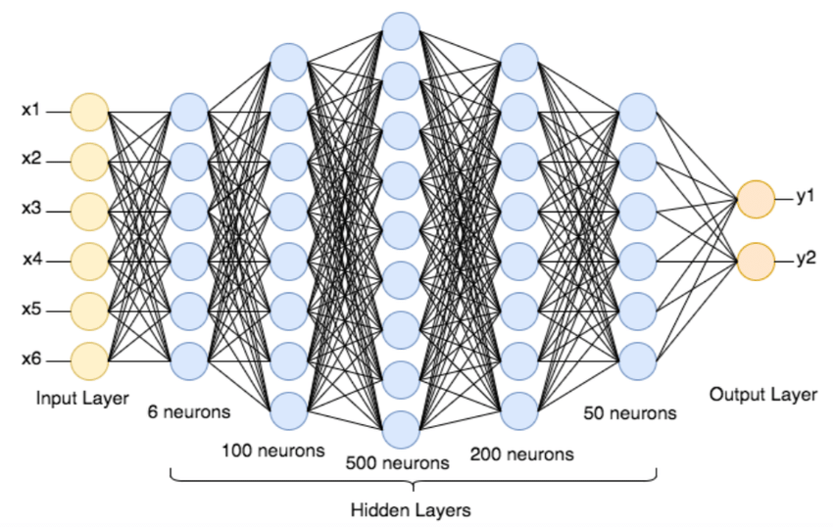
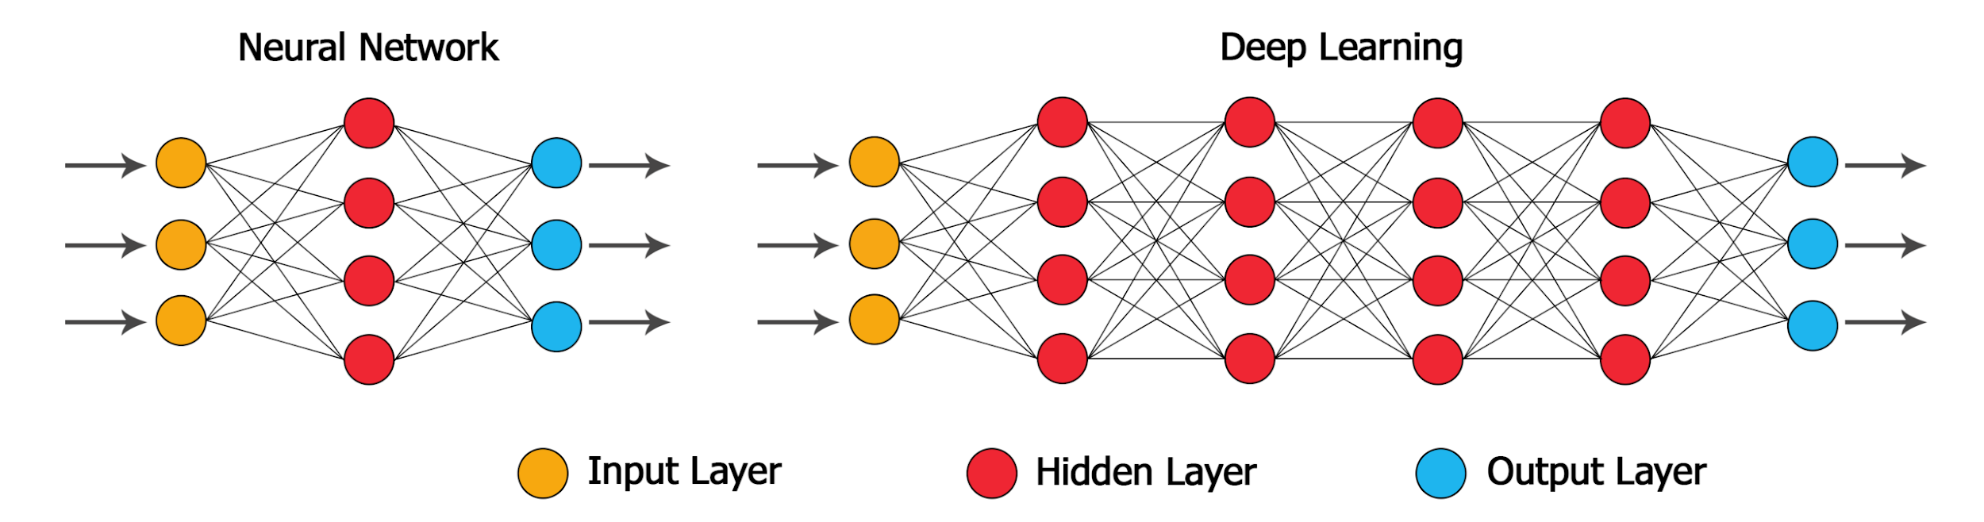
Building A “Deep” Neural Networks
Many neurons are stacked to form a layer and many layers are stacked to form NN.
Number of neurons in each layer and number of layers (depth) can vary and are hyperparameter.
“Deep” in deep learning actually refers to large “depth” of neural architecture.

Slide 8
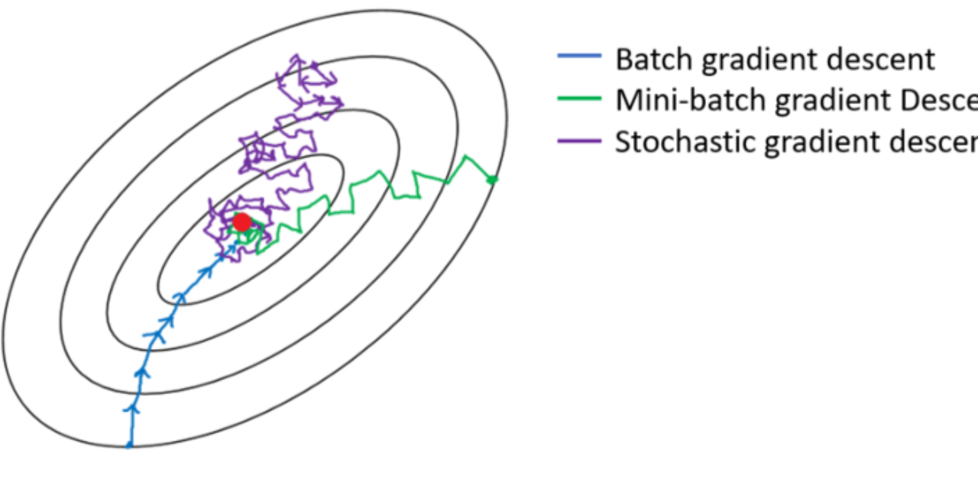
Training of a Deep NN
Stochastic Gradient Descent is an optimizing algorithm that adjusts the weights to minimize the loss. It is iterative algorithms which performs steps.
Make predictions on some data (batch)
Compute Loss on the predictions
Update parameters to minimise the loss
Iterate on these step until loss is below
certain threshold value.
Predictions are made using Forward Propagation, where we sweeps all layer starting from input layer to output layer, calculating outputs of all neurons.

Slide 9
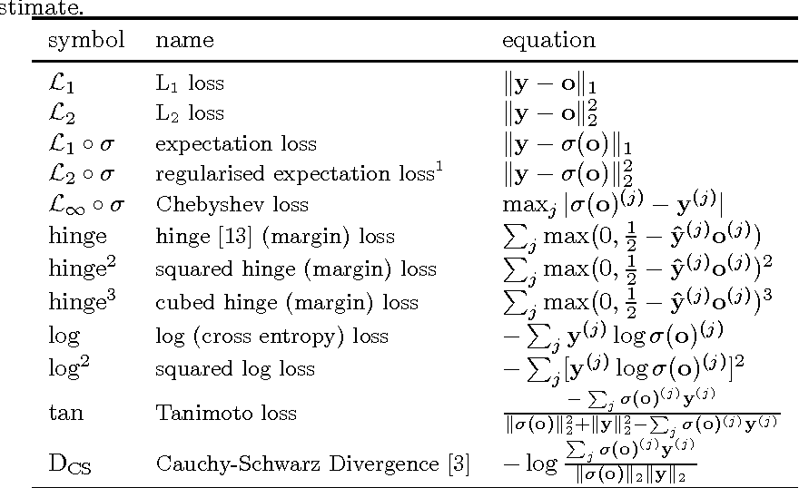
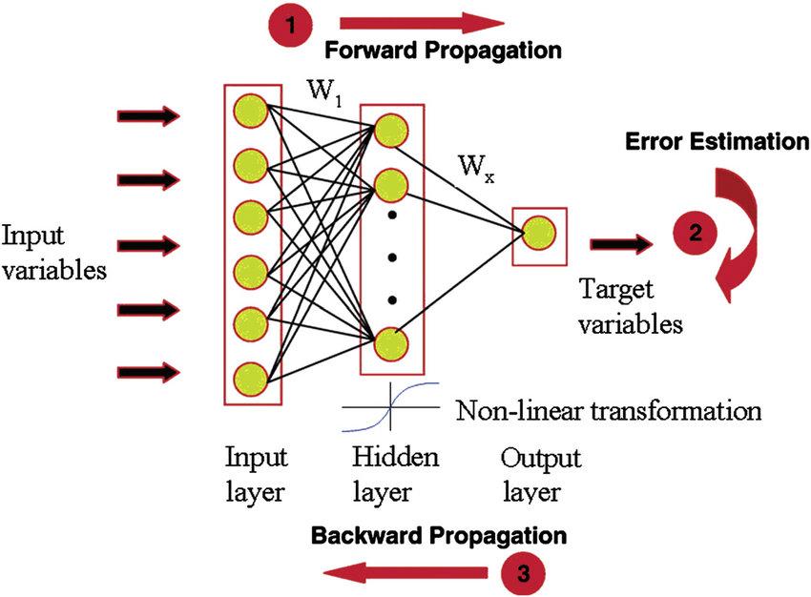
Back Propagation in NN
Loss are computed using a function called Loss Function.
In Back Prop, model sweeps layers in reverse order and find partial derivative of loss function wrt. parameters and update them to minimise the loss function.
This is step is heart of Deep Learning as “learning” happens here.
Learning Rate and Batch Size are hyperparameters needed to be tuned using validation data.

Slide 10
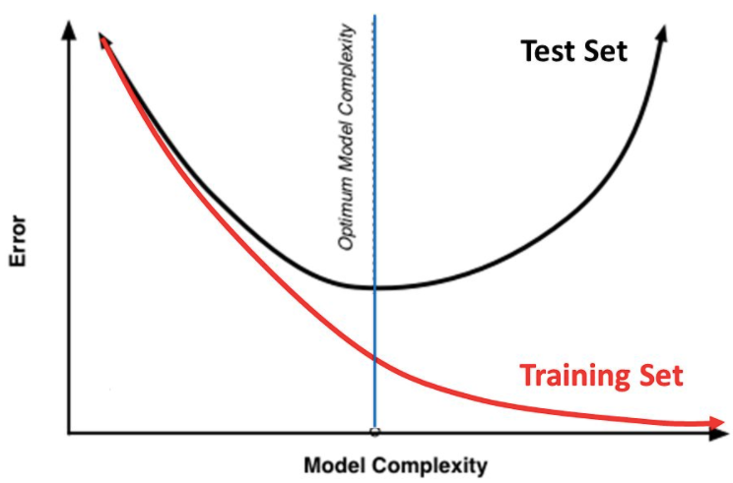

Overfitting
Deep Neural Networks performs “too well” on not so complex data which drops performance on test data.
Solution: Regularization
Weight Decay Method
Dropout Method
Early Stopping
Weight Decay Method
Total Loss: L = ( ∑_{i} L_{i}² + λ.∑_{i}||w||_{F}² ) / m
It brings activation closer to the origin.
So, as area near origin lies in linear range and model CANNOT learn complex nonlinear models.
Linear Range

Slide 11
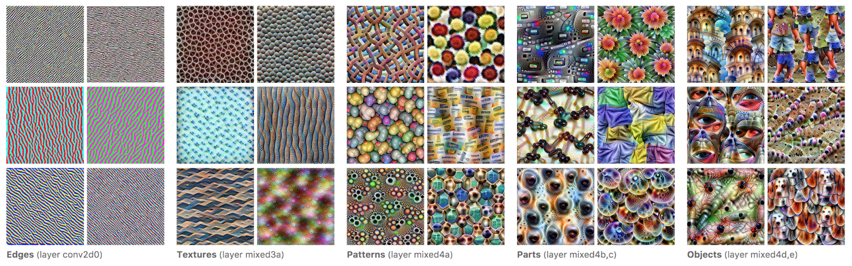
What actually is happening inside a NN?
During training, each neuron learns a specific feature.
Neurons in shallow layer learns simple feature (lines or curves) whereas in deeper layer learns complex features (facial features like nose).
Each neuron in a single layer learns features of same complexity (nearly).
It is necessary to randomly initialise weights to a non-zero value, otherwise all neurons in one single layer will always same value (learn same feature).

Slide 12
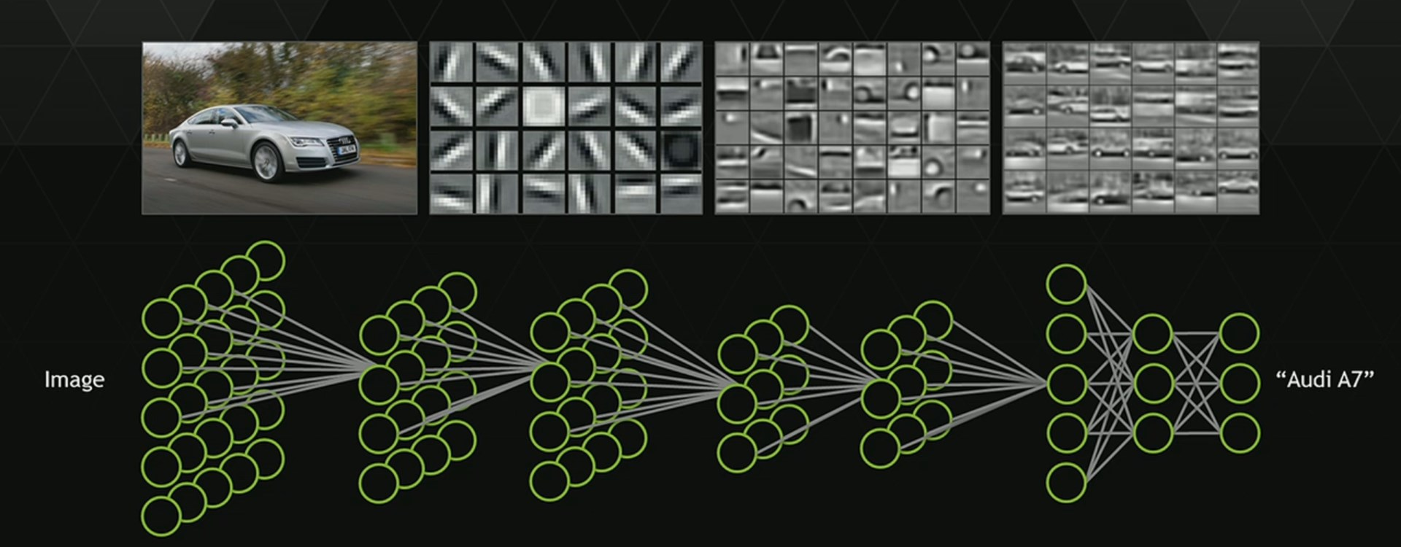
Visualizing features learned at each layer

Slide 13
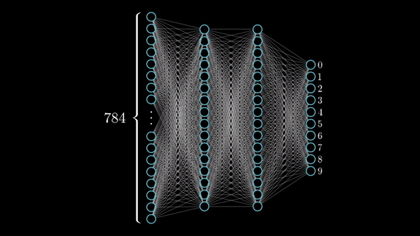
Visualizing a Working NN!
In each layer neurons are activated when feature they learned is detected in the image.

Slide 14


Disadvantages of Deep Learning
Large dataset are required to train a “good” deep neural network.
Using “Sigmoid” Act. Fun., training slows down at the end.
Solution: Use ReLU act. fun.
A good NN model contain thousands or even millions of parameters.
Have to write large complex code to get a good model.
Solution: Use frameworks like TensorFlow, Keras, etc.
Training process requires high computational power and is time taking.
Solution: Transfer Learning
Require to tune lots of hyperparameters
Learning Rate Number of Layers Number of neuron in each layer | λ (in regularization) Number of iterations (epoch) Batch Size

Slide 15

References
Kaggle DL course: https://www.kaggle.com/learn/intro-to-deep-learning
DL Explained (Melanie Swan): https://www.slideshare.net/lablogga/deep-learning-explained
CS771A: Intro to Machine Learning Slides, IIT Kanpur by Prof Purushottam Kar
Deep Learning Coursera, by Andrew NG: https://www.coursera.org/programs/indian-institute-of-technology-kanpur-on-coursera-4adct?collectionId=&currentTab=MY_COURSES&productId=W62RsyrdEeeFQQqyuQaohA&productType=s12n&showMiniModal=true
3Blue1Brown: https://www.youtube.com/watch?v=aircAruvnKk&t=108s
https://medium.com/@xzz201920/activation-functions-linear-non-linear-in-deep-learning-relu-sigmoid-softmax-swish-leaky-relu-a6333be712ea
https://medium.com/@jorgesleonel/hyperparameters-in-machine-deep-learning-ca69ad10b981
https://towardsdatascience.com/why-deep-learning-is-needed-over-traditional-machine-learning-1b6a99177063#:~:text=When%20there%20is%20lack%20of,language%20processing%2C%20and%20speech%20recognition.
https://towardsdatascience.com/a-comprehensive-guide-to-convolutional-neural-networks-the-eli5-way-3bd2b1164a53
https://www.cleanpng.com/png-rubbish-bins-waste-paper-baskets-hazardous-waste-w-4062584/
Google Images

Slide 16

Questions???
Some food for thoughts:
Combination of traditional machine learning techniques with DL!
To decrease training time, can we use some pre-computational methods?
What NN architecture to use for text and image data?

